Slide 1
Classification of bone fracture from 2D x-ray images using transfer learning and attention module on FracAtlas dataset THESIS
Presented by:
Sayeda Sanzida Ferdous Ruhi CSE 072 08182 & Fokrun Nahar CSE 072 08192
Supervised by: Adnan Ferdous Ashrafi Senior Lecturer
Department of Computer Science and Engineering STAMFORD UNIVERSITY BANGLADESH
March 2024

Slide 2
Thesis Presentation Outline
Title Slide
01
Introduction
03
Literature Review
04
Methodology
06
Proposed Methodology
08
Result Analysis
11
Discussion
16
Conclusions
17
Reference Slide
20
Notes:
https://pixabay.com/en/books-science-shelf-library-book-408220/

Slide 3
Introduction
01
02
03
Motivation
Research Outcome
Types of tool
Enhanced Efficiency
Good Precision
Educational Empowerment
Attenuated Model Creation
Superior Accuracy
Robust Validation
Pre-trained models
Matplotlib
Numpy
Pandas
Tensorflow
Open-CV

Slide 4
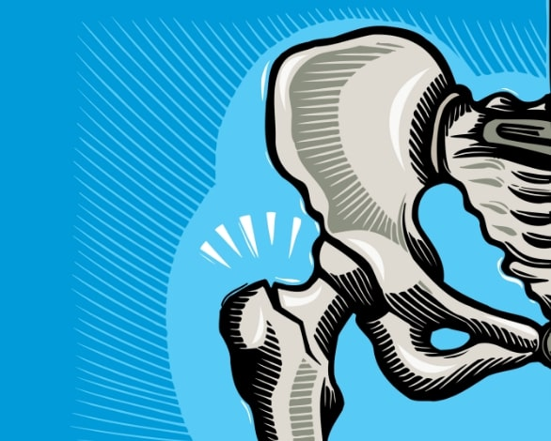
Literature Review
Research paper related to this domain:
Recognition and Classification of Knee Osteoporosis and Osteoarthritis Severity using Deep Learning Techniques
01
Works with 2 models:
VGG16 and Late Fusion
Got accuracy 77% for Late fusion model & 82% for VGG16 model
02
KONet: Toward a Weighted Ensemble Learning Model for Knee Osteoporosis Classification
Works with 7 models:
DenseNet121, Mobilenet, EfficientNetb0, Resnet50, Vgg19, KONet, InceptionV3
Got accuracy 97% for their proposed model KONet
03
Attention mechanism-based deep learning method for hairline fracture detection in hand X-rays
Works with ResNeXt and WristNet model
Got ap 56.6% for their proposed model WristNet
Notes:
https://pixabay.com/en/thumbs-up-okay-good-well-done-2056022/

Slide 5
Literature Review
Research paper related to this domain: (Cont……)
Classification of Shoulder X-ray Images with Deep Learning Ensemble Models
04
Works with different models, such as:
ResNet, ResNext, DenseNet, VGG, Inception, MobileNet
Got 2 accuracies for 2 ensemble models. EL1 got 84.55% and EL2 got 84.72%
Dense Dilated Attentive Network for Automatic Classification of Femur Trochanteric Fracture
05
Works with DDA layer to make model learn multiclass
Got AUC 97% for their proposed DDA network
Fuzzy Rank-Based Ensemble Model for Accurate Diagnosis of Osteoporosis in Knee Radiographs
06
Works with 3 models:
InceptionV3, Xception, ResNet18
Got 93.5% accuracy for their proposed ensemble model
Notes:
https://pixabay.com/en/thumbs-up-okay-good-well-done-2056022/

Slide 6
Methodology
Dataset
Description
Dataset
preprocessing
Implementation of
pre-trained models
Name: FracAtlas
Classes:
Fractured
Non-fractured
Total images 4083
Fractured images -717
Non-fractured images-3366
Resolution:
2304×2880.
dataset splits into 3 sets:
80% training set
8.5%test set
11.5% validation set
Remove the corrupted images from dataset
resized the image shapes from 2304×2880 to 224×224
InceptionV3
EfficientNetV2B2
DenseNet121
EfficientNetB1
Inception-v4

Slide 7
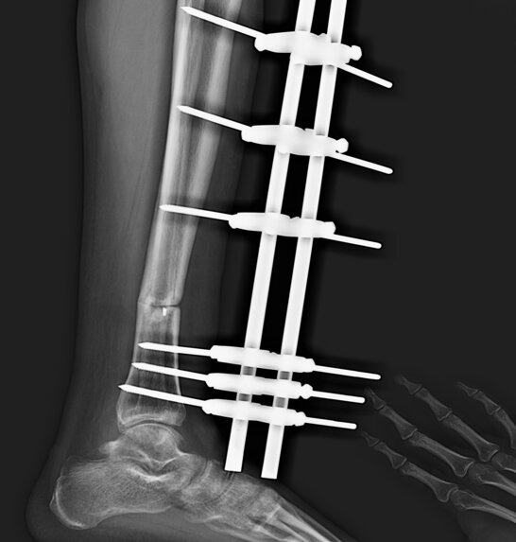
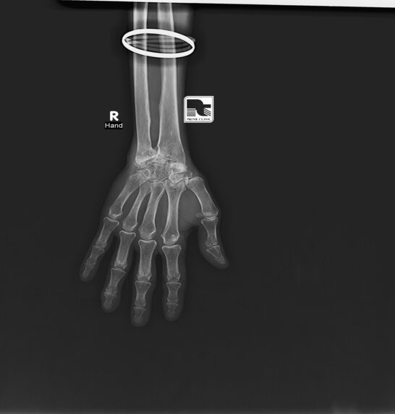
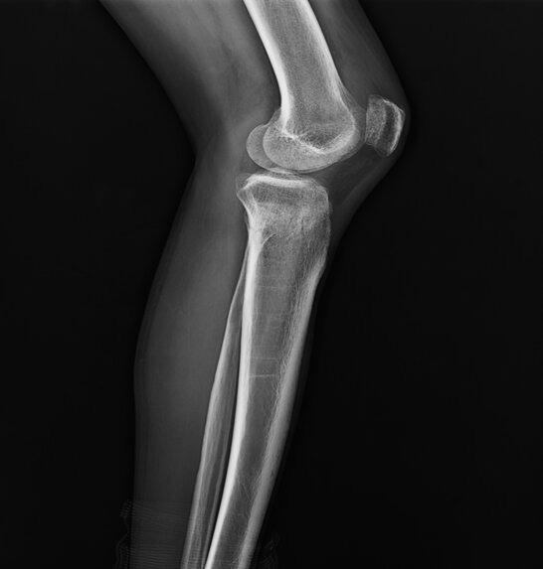
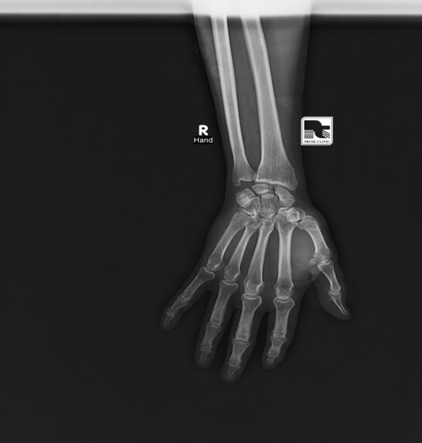
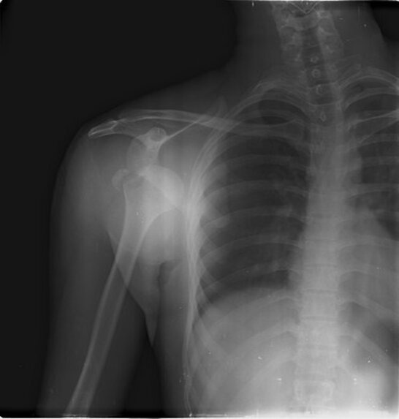
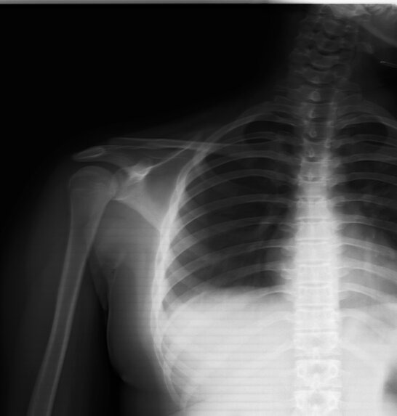
Here are some samples of images from our dataset
Fractured images
Non-fractured images

Slide 8
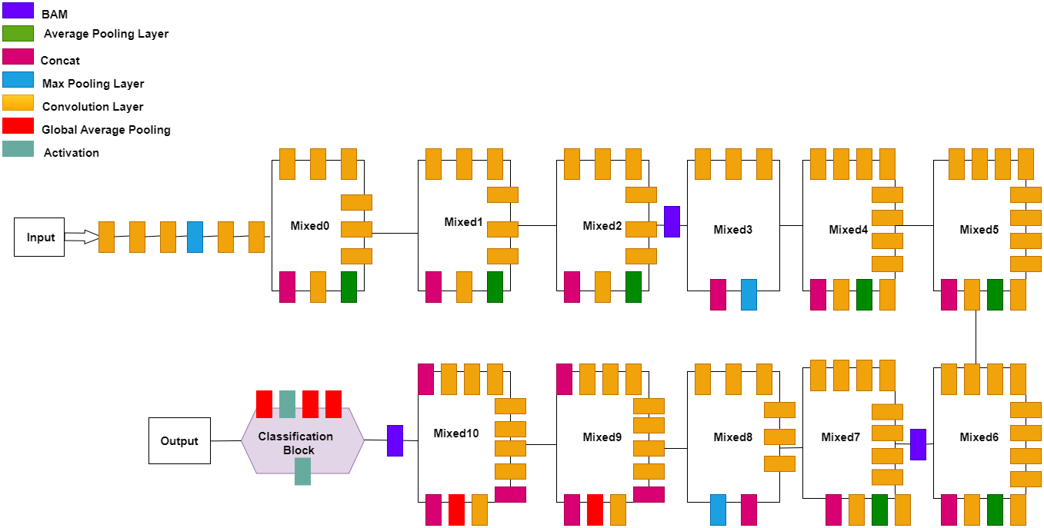
Proposed Methodology
Worked with two experiments
Implementation of
pre-trained models
Experiment-1:
Added three BAMs:
first BAM is added after ”mixed 2” layers and it connected with 288 channels.
second BAM is added after ”mixed 6” layers and it connects with 768 channels.
last BAM is added after ”mixed 10” and it connects with 2048 channels.

Slide 9
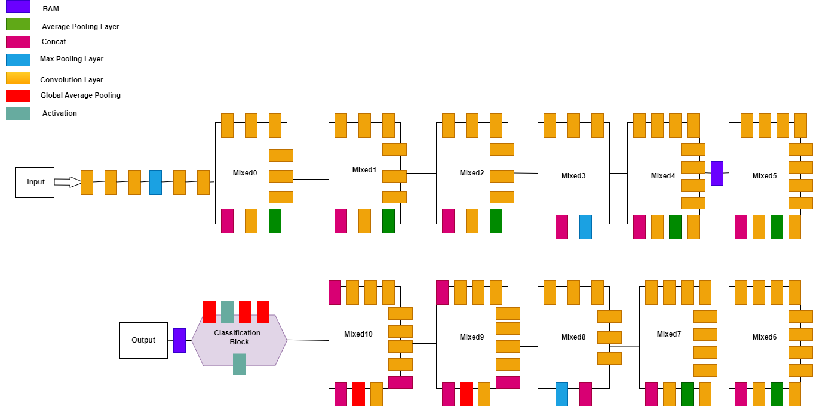
Proposed Methodology
Implementation of
pre-trained models
Experiment-2:
Added two BAMS:
first BAM is added after ”mixed 4” layers and connect with 768 channels.
last BAM is added after the average pooling of ”mixed 10” layers and connect with 2048 channels.

Slide 10
Proposed Methodology
BAM attention module
Evaluation metrics
a new module that is designed to be integrated with any feed-forward CNNs.
infers an attention map along two separate pathways, channel and spatial.
constructs a hierarchical attention at bottlenecks with a number of parameters.
trainable in an end-to-end manner jointly with any feed-forward models.
Accuracy
Precision
Recall
F1-score

Slide 11
Result Analysis
Comparison Of Results Of Models Using Imagenet
Model | Test Accuracy | Test F1 score | Test Recall | Test Precision
Inception V3 | 0.9193 | 0.9201 | 0.9201 | 0.9201
EfficientNetV2B2 | 0.9049 | 0.9083 | 0.9083 | 0.9201
DenseNet121 | 0.9135 | 0.9145 | 0.9145 | 0.9145-
Inception-V4 | 0.8904 | 0.8901 | 0.8901 | 0.8901
EfficientNetB1 | 0.8991 | 0.8985 | 0.8985 | 0.8985

Slide 12
Result Analysis (Cont…)
Comparison Of Results Of Models Without Using Imagenet
Model | Test Accuracy | Test F1 score | Test Recall | Test Precision
Inception V3 | 0.8905 | 0.8923 | 0.8923 | 0.8923
EfficientNetV2B2 | 0.8646 | 0.8652 | 0.8652 | 0.8652
DenseNet121 | 0.8905 | 0.8902 | 0.8902 | 0.8902
Inception-V4 | 0.8731 | 0.8735 | 0.8735 | 0.8735
EfficientNetB1 | 0.8472 | 0.8485 | 0.8485 | 0.8485

Slide 13
Result Analysis (Cont…)
Results Of 2 Experiments Of InceptionV3 After Adding BAM
Experiment No | Test Accuracy | Test F1 score | Test Recall | Test Precision
Experiment1 | 0.9020 | 0.9034 | 0.9034 | 0.9034
Experiment2 | 0.9020 | 0.9022 | 0.9022 | 0.9022

Slide 14
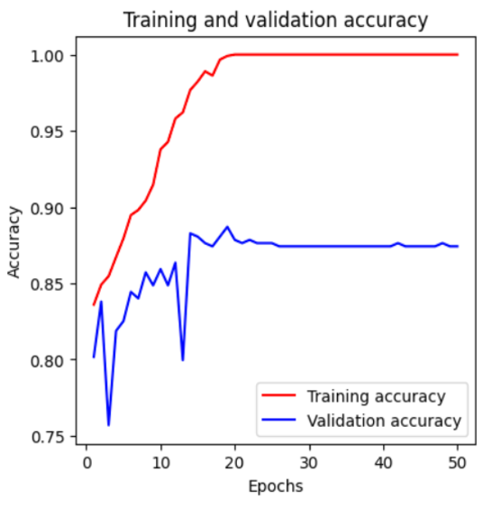
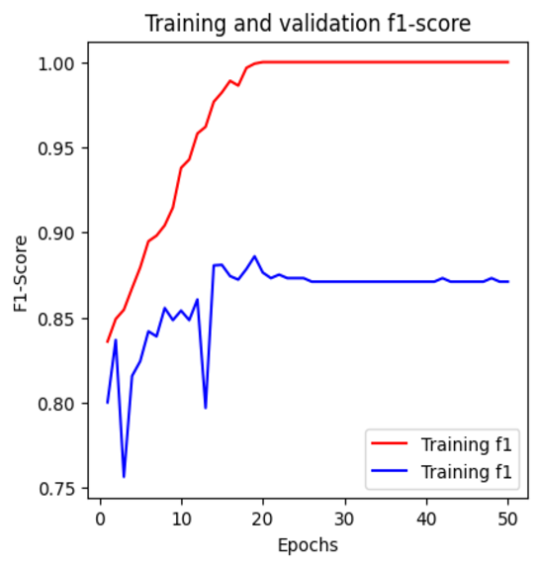
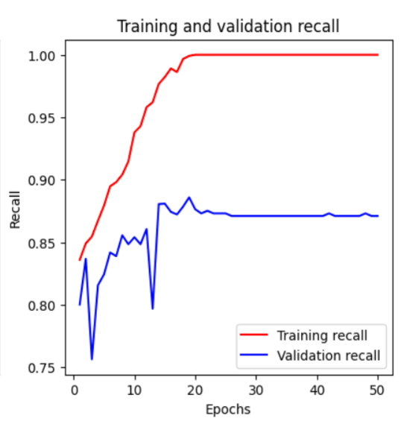
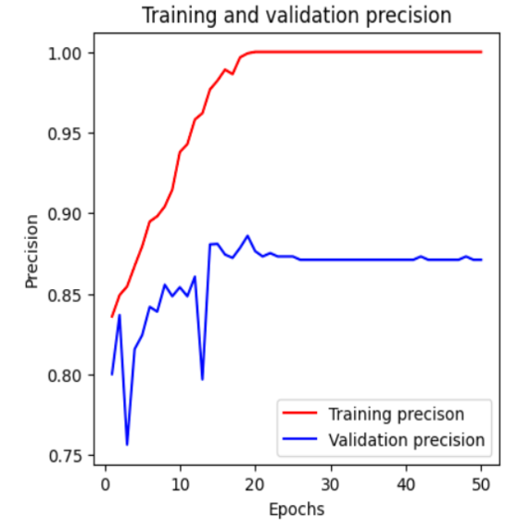
Graphs showing results of various evaluation metrics
Experiment:1

Slide 15
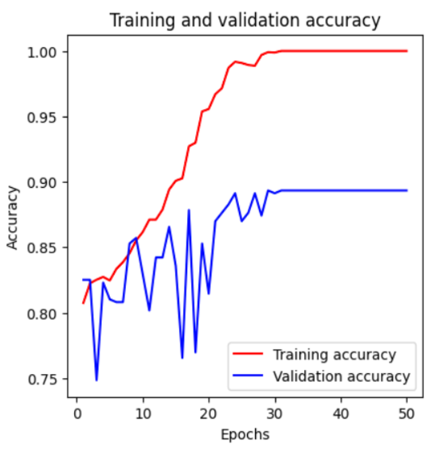
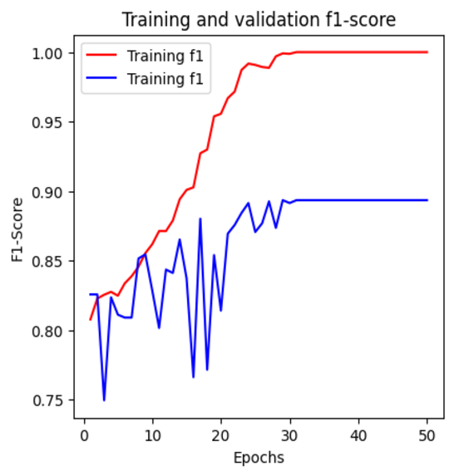
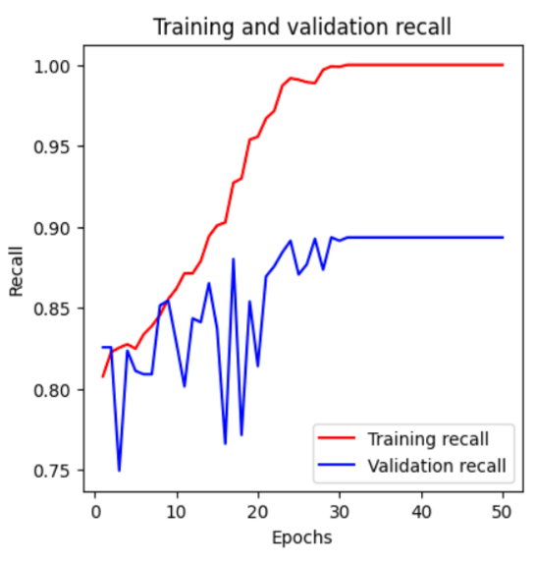
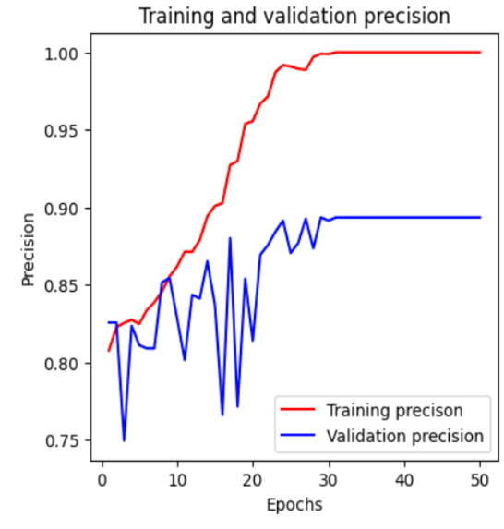
Graphs showing results of various evaluation metrics
Experiment:2

Slide 16
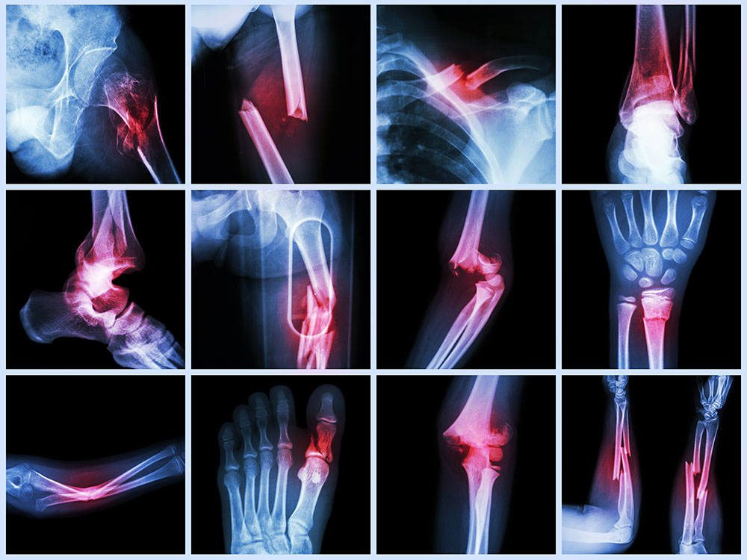
Discussion
01
02
03
InceptionV3 provides us with better results than the other models and that is 89.05%.
DenseNet121 provides us the same accuracy but it is less efficient in terms of precision, recall and f1-score.
After adding attention module BAM inside its layers, it provides us more accuracy and that is 90.2% and also increases the other three evaluating metrics.
Notes:
https://pixabay.com/en/workplace-team-business-meeting-1245776/

Slide 17
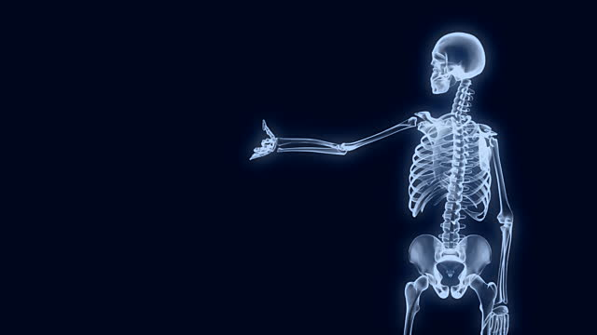
Conclusions

Slide 18
Limitations
01
over-fitted in some cases.
02
didn’t get good result for validation when working with other datasets.
03
not competent to work with multi-classes.

Slide 19
Future Research
01
make our model better and handle its over-fitting problem.
02
create a model that can classify multi-class datasets.
03
develop a software that can classify fractures from X-ray images.
04
checking validation with more datasets.

Slide 20
References
01
Broken Bones, Broken Lives: A Roadmap to Solve the Fragility Fracture Crisis in Europe. International Osteoporosis Foundation, 2018. [Online]. Available: https://www.osteoporosis.foundation/what-we-do/science-andresearch/latest-projects–broken-bones-broken-lives
I. Abedeen, M. A. Rahman, F. Z. Prottyasha, T. Ahmed, T. M. Chowdhury, and S. Shatabda, “Fracatlas: A dataset for fracture classification, localization and segmentation of musculoskeletal radiographs,” Scientific Data, vol. 10, no. 1, p. 521, 2023.
02
03
“Bone fracture.” [Online]. Available: https://www.kaggle.com/datasets/ahmedashrafahmed/bone-fracture.
P. Rajpurkar, J. Irvin, A. Bagul, D. Ding, T. Duan, H. Mehta, B. Yang, K. Zhu,
D. Laird, R. L. Ball, C. Langlotz, K. Shpanskaya, M. P. Lungren, and A. Y. Ng,
“Mura,” 2018. [Online]. Available: https://arxiv.org/abs/1712.06957
04
05
Team, “keras,” 2015. [Online]. Available: https://github.com/keras-team/keras

Slide 21

Any questions?
Notes:
https://pixabay.com/en/question-mark-labyrinth-lost-maze-2648236/

Slide 22
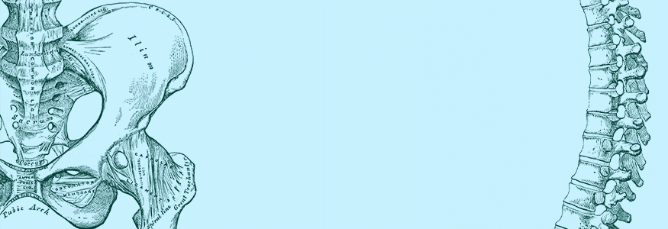
Thank You

